Slide 1

Olist Store Analysis
Project Mentor- Shubham Kabra sir
Group-5 Members Name
Miss . Vrushali Dinkar Patil.
Mr. Junaid Risvan T
Mrs.Pratik Prashant Raghatate
Mr.Akshay R. Rashinkar

Slide 2




Analytics Tools

Slide 3

Joins used in Tools

Slide 4
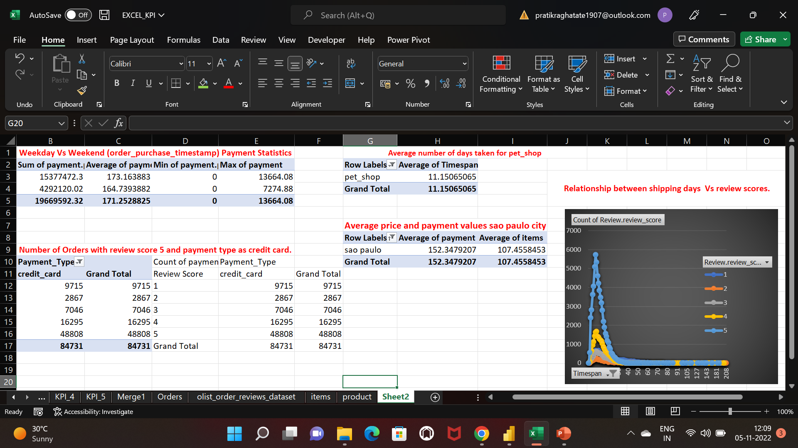
Analysis in Excel

Slide 5
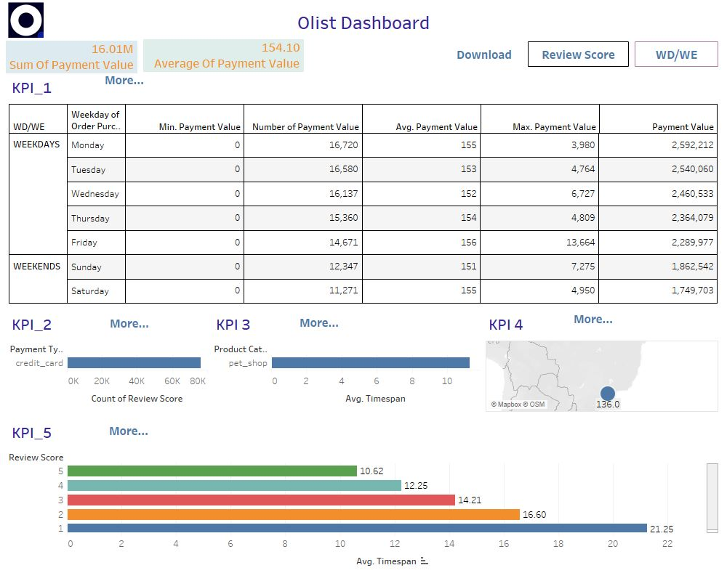
Analysis in Tableau

Slide 6
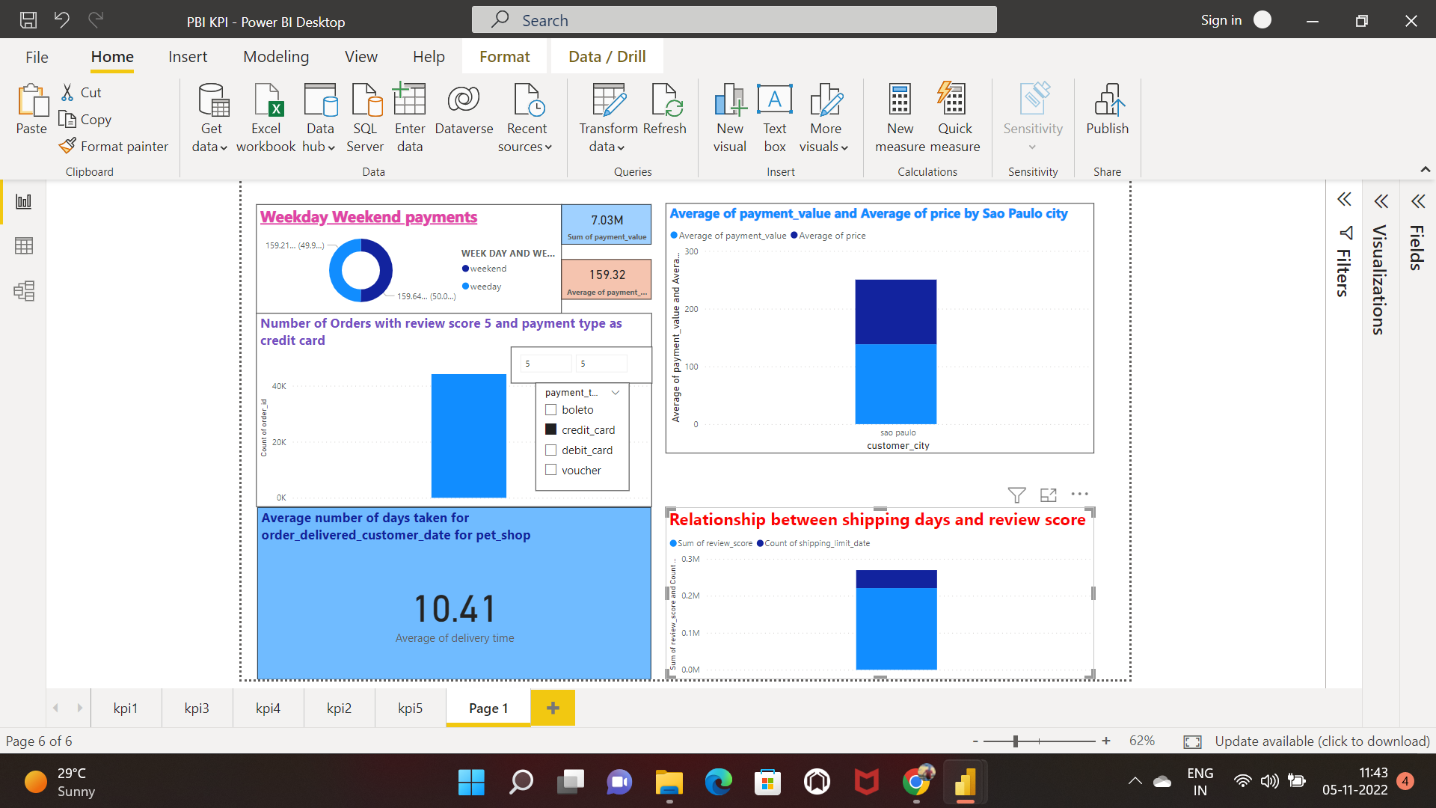
Analysis in PowerBi

Slide 7
Thank You

